Slide 1

Database Systems:
Design, Implementation, and Management
Tenth Edition
Chapter 2
Data Models
Database Systems, 10th Edition

Slide 2
Objectives
In this chapter, you will learn:
About data modeling and why data models are important
About the basic data-modeling building blocks
What business rules are and how they influence database design
How the major data models evolved
Database Systems, 10th Edition

Slide 3
Objectives (cont’d.)
About emerging alternative data models and the need they fulfill
How data models can be classified by their level of abstraction
Database Systems, 10th Edition

Slide 4
Introduction
Designers, programmers, and end users see data in different ways
Different views of same data lead to designs that do not reflect organization’s operation
Data modeling reduces complexities of database design
Various degrees of data abstraction help reconcile varying views of same data
Database Systems, 10th Edition

Slide 5
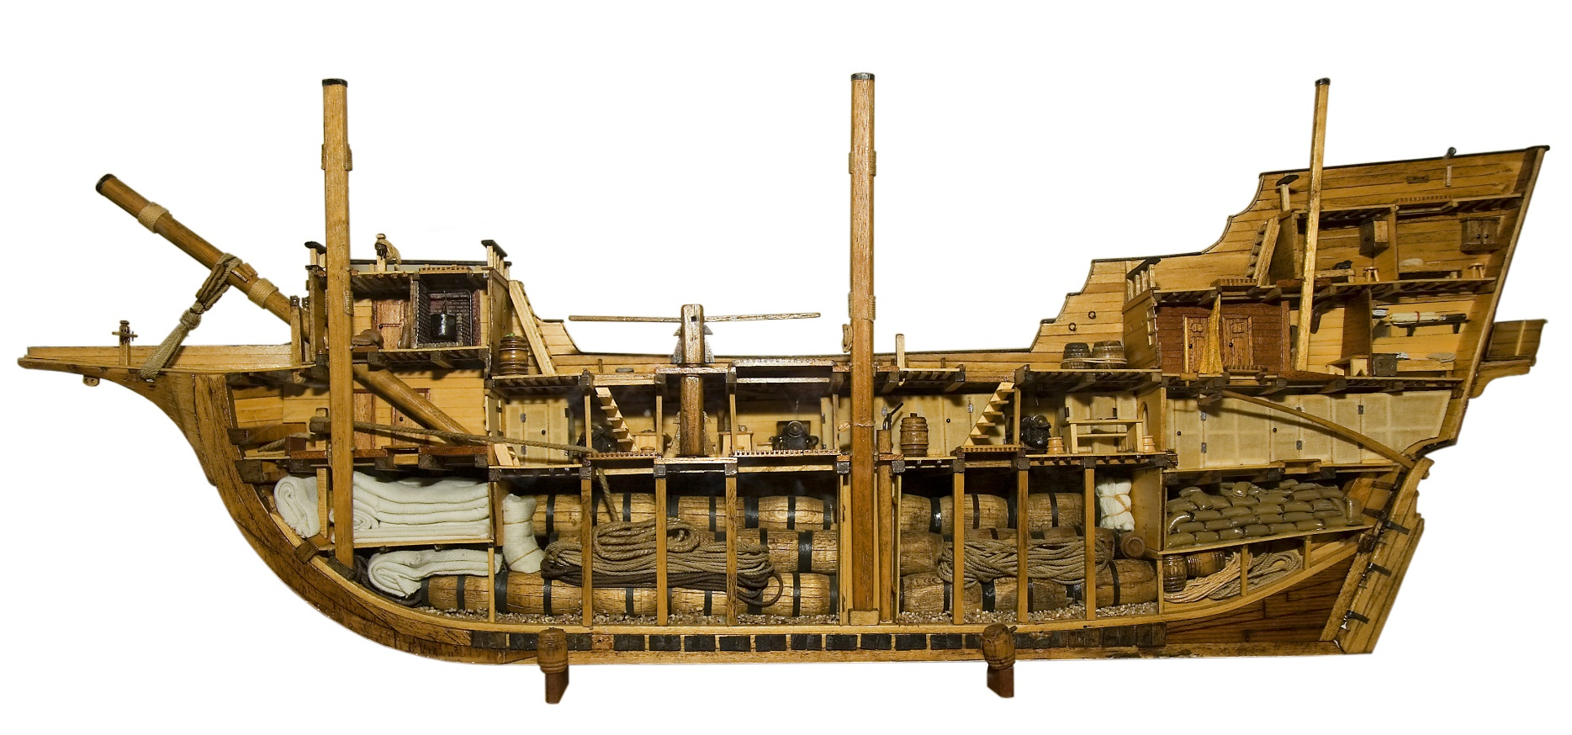
Wikipedia Ship Model
Database Systems, 10th Edition

Slide 6
Data Modeling and Data Models
Data models
  Relatively simple representations of complex real-world data structures
    Often graphical
Model: an abstraction of a real-world object or event
  Useful in understanding complexities of the real-world environment
Data modeling is iterative and progressive
Database Systems, 10th Edition

Slide 7
The Importance of Data Models
Facilitate interaction among the designer, the applications programmer, and the end user
End users have different views and needs for data
Data model organizes data for various users
Data model is an abstraction
  Cannot draw required data out of the data model
Database Systems, 10th Edition

Slide 8
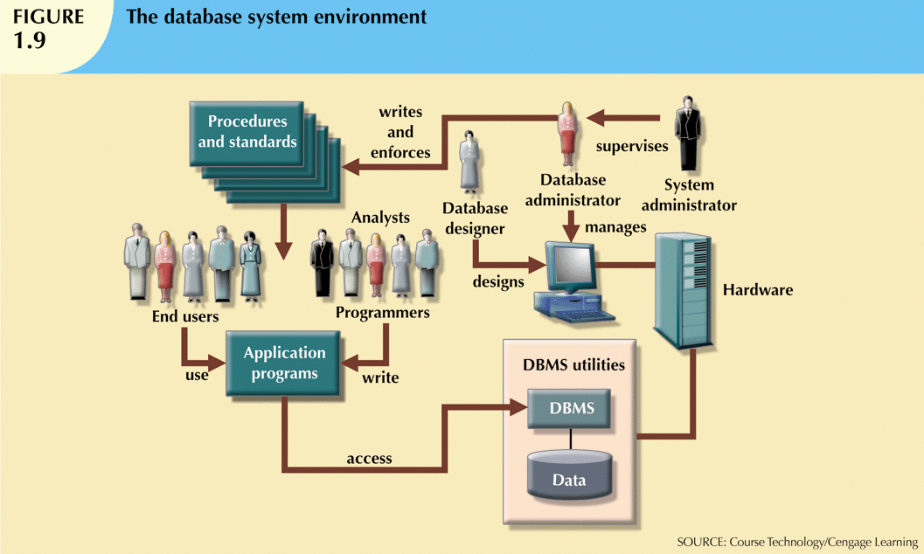
Database Systems, 10th Edition

Slide 9
Data Model Basic Building Blocks
Entity: anything about which data are to be collected and stored
Attribute: a characteristic of an entity
Relationship: describes an association among entities
  One-to-many (1:M) relationship
  Many-to-many (M:N or M:M) relationship
  One-to-one (1:1) relationship
Constraint: a restriction placed on the data
Database Systems, 10th Edition

Slide 10
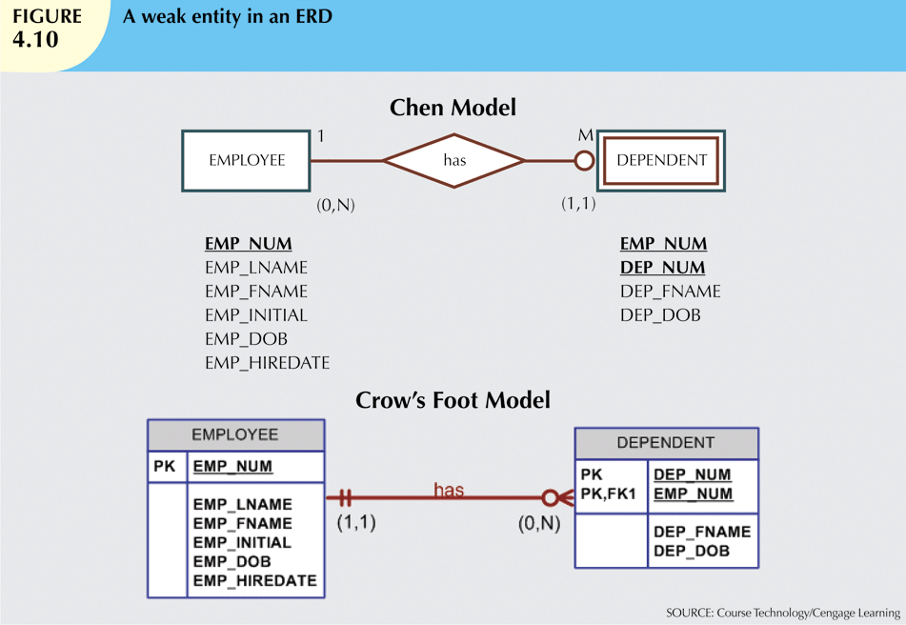
Database Systems, 10th Edition

Slide 11
Entity Attribute Examples
An Entity might be
  employees
  buildings
  customer accounts
An Attribute might be
  an employee number
  number of floors
  a customer balance
Database Systems, 10th Edition

Slide 12
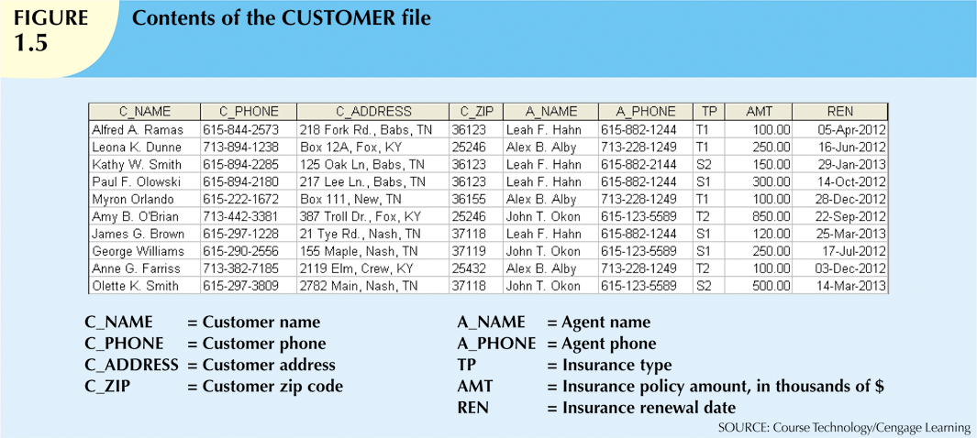
Database Systems, 10th Edition

Slide 13
Relationship Examples
A 1:1 Relationship might be
  One company has one CEO
A 1:M Relationship might be
  One department has many employees
  One building has many floors
A M:N Relationship might be
  Many students have many classes
  Many store branches sell many products
Database Systems, 10th Edition

Slide 14
Business Rules
Descriptions of policies, procedures, or principles within a specific organization
  Apply to any organization that stores and uses data to generate information
Description of operations to create/enforce actions within an organization’s environment
  Must be in writing and kept up to date
  Must be easy to understand and widely disseminated
Describe characteristics of data as viewed by the company
Database Systems, 10th Edition

Slide 15
Sample Business Rules
One Department has many employees
Employees have one department
One Department has one department head
Department heads lead one department
Many Departments participate in many projects
Database Systems, 10th Edition

Slide 16
Discovering Business Rules
Sources of business rules:
  Company managers
  Policy makers
  Department managers
  Written documentation
    Procedures
    Standards
    Operations manuals
  Direct interviews with end users
Database Systems, 10th Edition

Slide 17
Discovering Business Rules (cont’d.)
Standardize company’s view of data
Communications tool between users and designers
Allow designer to understand the nature, role, and scope of data
Allow designer to understand business processes
Allow designer to develop appropriate relationship participation rules and constraints
Database Systems, 10th Edition

Slide 18
Translating Business Rules into Data Model Components
Nouns translate into entities
Verbs translate into relationships among entities
Relationships are bidirectional
Two questions to identify the relationship type:
  How many instances of B are related to one instance of A?
  How many instances of A are related to one instance of B?
Database Systems, 10th Edition

Slide 19
Naming Conventions
Naming occurs during translation of business rules to data model components
Names should make the object unique and distinguishable from other objects
Names should also be descriptive of objects in the environment and be familiar to users
Proper naming:
  Facilitates communication between parties
  Promotes self-documentation
Database Systems, 10th Edition

Slide 20
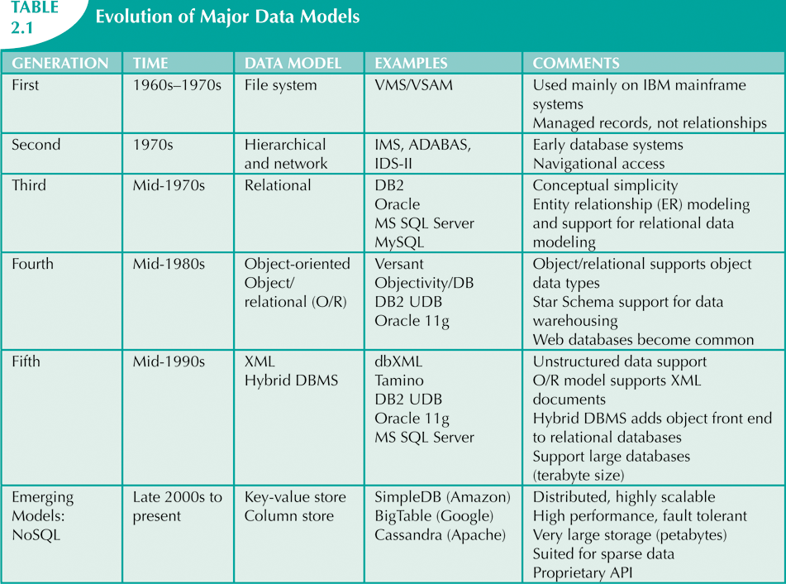
The Evolution of Data Models
Database Systems, 10th Edition

Slide 21
Sequential & Random Access
Before there was Indexed Sequential there were Sequential Files and Random Access Files
Sequential Files were on cards, punch tape, magnetic tape and disk
Random Access files supported by disk
Database Systems, 10th Edition

Slide 22
Index Sequential
Records found in sequential file by reading until you find it
Problem finding record on Random Access File
An index gives you the address of the record just as a book’s index gives you the page of your information.
Database Systems, 10th Edition

Slide 23
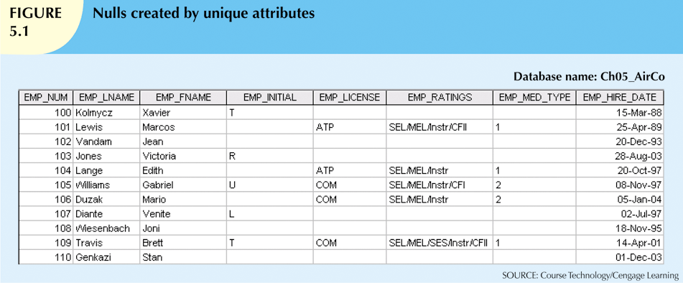
Database Systems, 10th Edition

Slide 24
Hierarchical and Network Models
The hierarchical model
  Developed in the 1960s to manage large amounts of data for manufacturing projects
  Basic logical structure is represented by an upside-down “tree”
  Structure contains levels or segments
Database Systems, 10th Edition

Slide 25
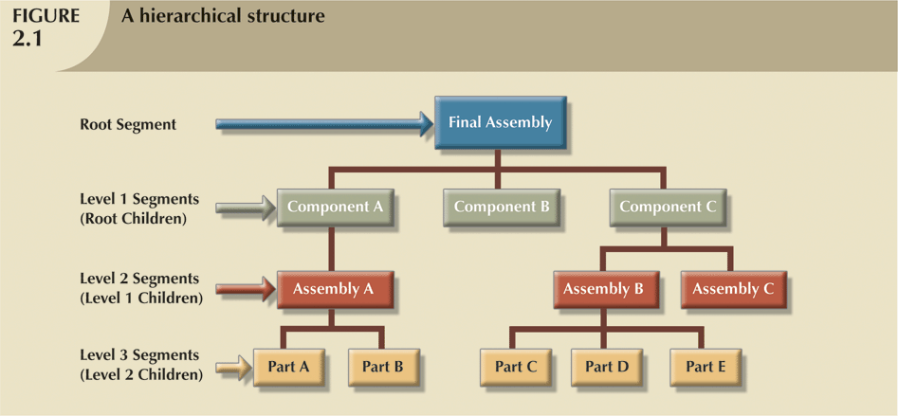

Slide 26
Hierarchical and Network Models (cont’d.1)
Network model
  Created to represent complex data relationships more effectively than the hierarchical model
  Resembles hierarchical model
    Record may have more than one parent
Database Systems, 10th Edition

Slide 27
Hierarchical and Network Models (cont’d.2)
Network model
  Improved database performance
  Imposed a database standard
    CODASYL (COBOL standard)
    DBTG (DataBase Task Group)
Database Systems, 10th Edition

Slide 28
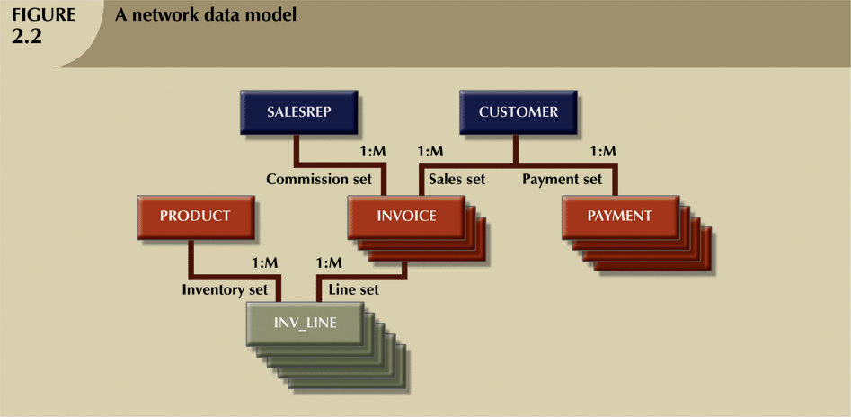

Slide 29
Hierarchical and Network Models (cont’d.)
  Collection of records in 1:M relationships
  Set composed of two record types:
    Owner
    Member
Network model concepts still used today:
  Schema
    Conceptual organization of entire database as viewed by the database administrator
  Subschema
    Database portion “seen” by the application programs
Database Systems, 10th Edition

Slide 30
Hierarchical and Network Models (cont’d.)
  Data management language (DML)
    Defines the environment in which data can be managed
  Data definition language (DDL)
    Enables the administrator to define the schema components
Database Systems, 10th Edition

Slide 31
The Relational Model
Developed by E.F. Codd (IBM) in 1970
Table (relations)
  Matrix consisting of row/column intersections
  Each row in a relation is called a tuple
Relational models were considered impractical in 1970
Model was conceptually simple at expense of computer overhead
Database Systems, 10th Edition

Slide 32
The Relational Model (cont’d.)
Relational data management system (RDBMS)
  Performs same functions provided by hierarchical model
  Hides complexity from the user
Relational diagram
  Representation of entities, attributes, and relationships
Relational table stores collection of related entities
Database Systems, 10th Edition

Slide 33
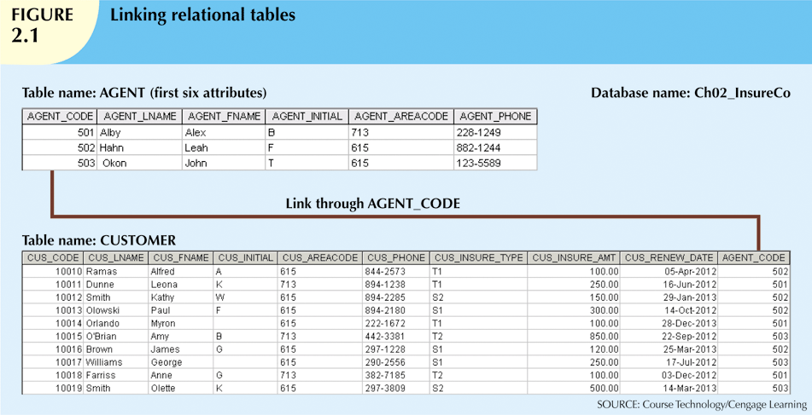
Database Systems, 10th Edition

Slide 34
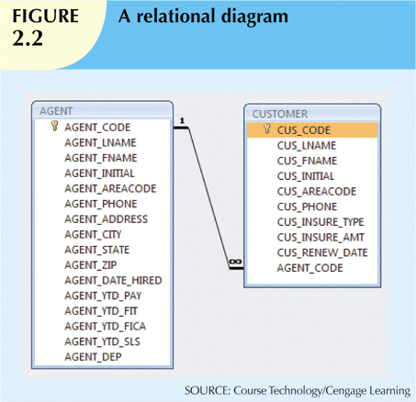
Database Systems, 10th Edition

Slide 35
The Relational Model (cont’d.)
SQL-based relational database application involves three parts:
  End-user interface
    Allows end user to interact with the data
  Set of tables stored in the database
    Each table is independent from another
    Rows in different tables are related based on common values in common attributes
  SQL “engine”
    Executes all queries
Database Systems, 10th Edition

Slide 36
The Entity Relationship Model
Widely accepted standard for data modeling
Introduced by Chen in 1976
Graphical representation of entities and their relationships in a database structure
Entity relationship diagram (ERD)
  Uses graphic representations to model database components
  Entity is mapped to a relational table
Database Systems, 10th Edition

Slide 37
The Entity Relationship Model (cont’d.)
Entity instance (or occurrence) is row in table
Entity set is collection of like entities
Connectivity labels types of relationships
Relationships are expressed using Chen notation
  Relationships are represented by a diamond
  Relationship name is written inside the diamond
Crow’s Foot notation used as design standard in this book
Database Systems, 10th Edition

Slide 38
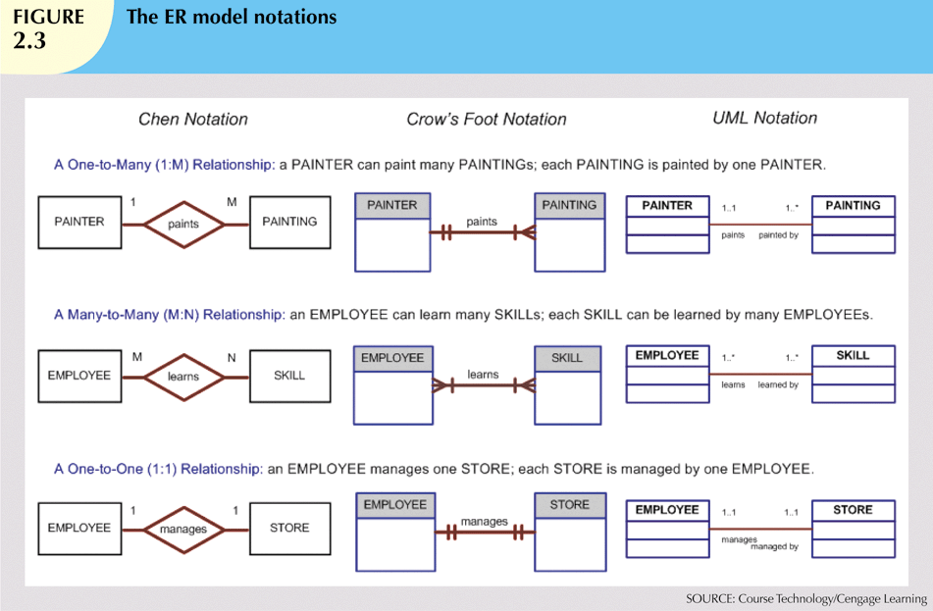
Database Systems, 10th Edition

Slide 39
The Object-Oriented (OO) Model
Data and relationships are contained in a single structure known as an object
OODM (object-oriented data model) is the basis for OODBMS
  Semantic data model
An object:
  Contains operations
  Are self-contained: a basic building-block for autonomous structures
  Is an abstraction of a real-world entity
Database Systems, 10th Edition

Slide 40
The Object-Oriented (OO) Model (cont’d.)
Attributes describe the properties of an object
Objects that share similar characteristics are grouped in classes
Classes are organized in a class hierarchy
Inheritance: object inherits methods and attributes of parent class
UML based on OO concepts that describe diagrams and symbols
  Used to graphically model a system
Database Systems, 10th Edition

Slide 41
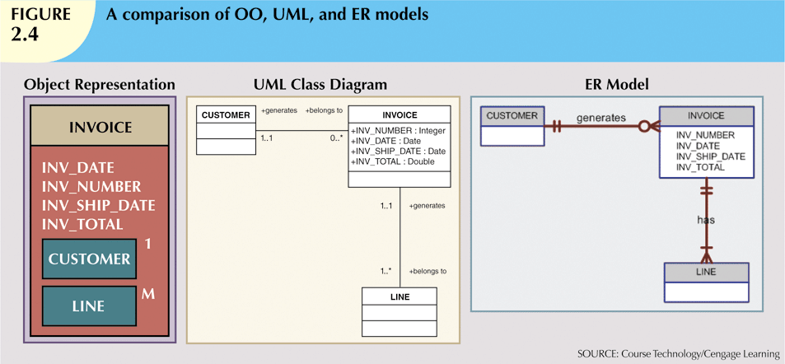
Database Systems, 10th Edition

Slide 42
Object/Relational and XML
Extended relational data model (ERDM)
  Semantic data model developed in response to increasing complexity of applications
  Includes many of OO model’s best features
  Often described as an object/relational database management system (O/RDBMS)
  Primarily geared to business applications
Database Systems, 10th Edition

Slide 43
Object/Relational and XML (cont’d.)
The Internet revolution created the potential to exchange critical business information
In this environment, Extensible Markup Language (XML) emerged as the de facto standard
Current databases support XML
  XML: the standard protocol for data exchange among systems and Internet services
Database Systems, 10th Edition

Slide 44
Emerging Data Models: Big Data and NoSQL
Big Data
  Find new and better ways to manage large amounts of Web-generated data and derive business insight from it
  Simultaneously provides high performance and scalability at a reasonable cost
  Relational approach does not always match the needs of organizations with Big Data challenges
Database Systems, 10th Edition

Slide 45
Emerging Data Models: Big Data and NoSQL (cont’d.)
NoSQL databases
  Not based on the relational model, hence the name NoSQL
  Supports distributed database architectures
  Provides high scalability, high availability, and fault tolerance
  Supports very large amounts of sparse data
  Geared toward performance rather than transaction consistency
Database Systems, 10th Edition

Slide 46
Emerging Data Models: Big Data and NoSQL (cont’d.)
Key-value data model
  Two data elements: key and value
    Every key has a corresponding value or set of values
Sparse data
  Number of attributes is very large
  Number of actual data instances is low
Eventual consistency
  Updates will propagate through system; eventually all data copies will be consistent
Database Systems, 10th Edition

Slide 47
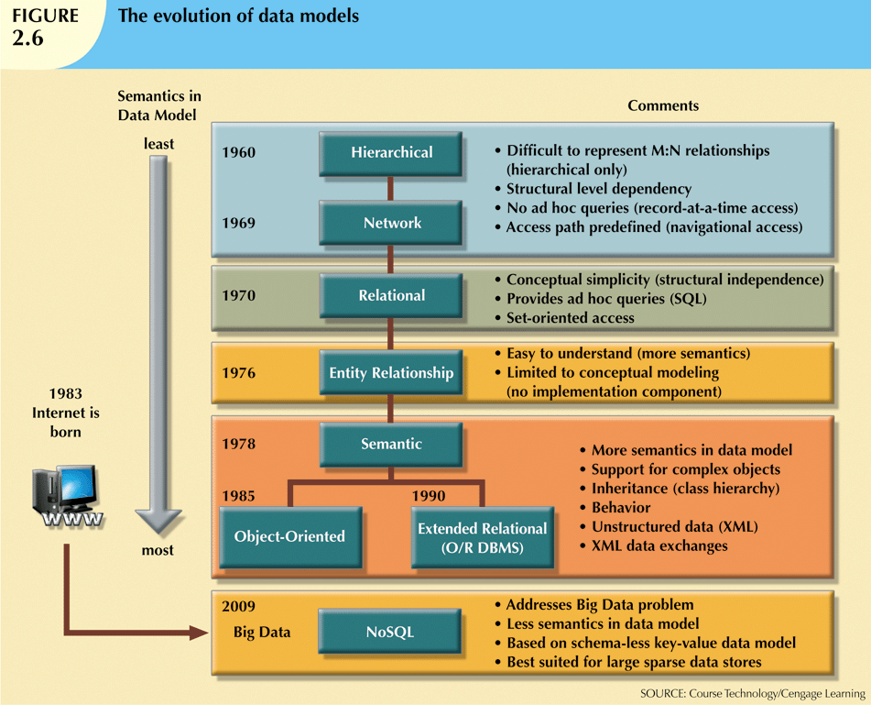
Database Systems, 10th Edition

Slide 48
Data Models: A Summary
Common characteristics:
  Conceptual simplicity with semantic completeness
  Represent the real world as closely as possible
  Real-world transformations must comply with consistency and integrity characteristics
Each new data model capitalized on the shortcomings of previous models
Some models better suited for some tasks
Database Systems, 10th Edition

Slide 49
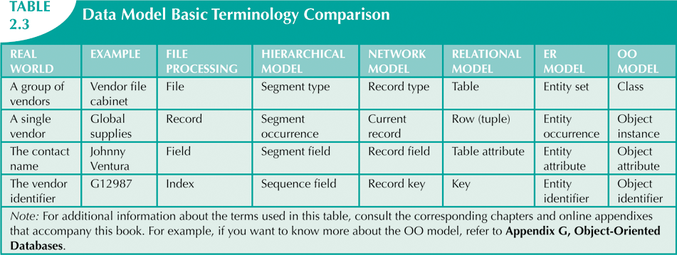
Database Systems, 10th Edition

Slide 50
Degrees of Data Abstraction
Database designer starts with abstracted view, then adds details
ANSI Standards Planning and Requirements Committee (SPARC)
  Defined a framework for data modeling based on degrees of data abstraction (1970s):
    External
    Conceptual
    Internal
Database Systems, 10th Edition

Slide 51
The External Model
End users’ view of the data environment
ER diagrams represent external views
External schema: specific representation of an external view
  Entities
  Relationships
  Processes
  Constraints
Database Systems, 10th Edition

Slide 52
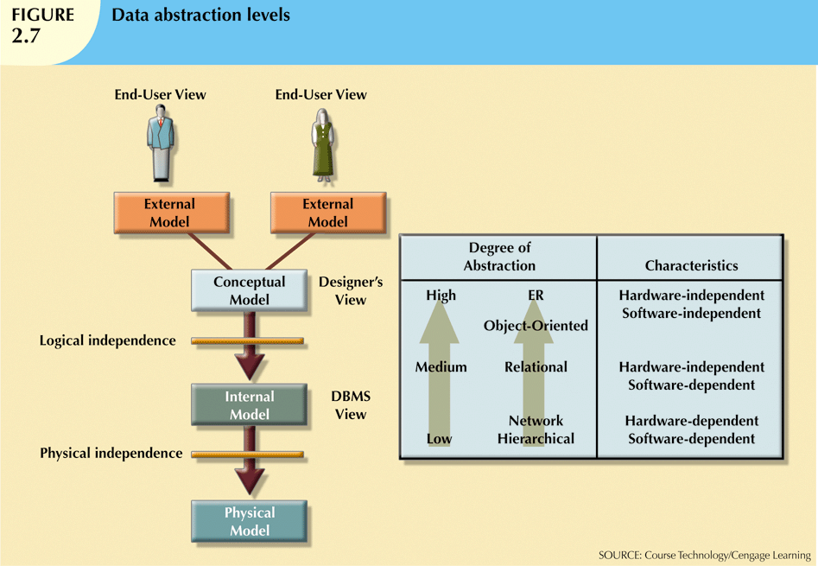
Database Systems, 10th Edition

Slide 53
The External Model (cont’d.)
Easy to identify specific data required to support each business unit’s operations
Facilitates designer’s job by providing feedback about the model’s adequacy
Ensures security constraints in database design
Simplifies application program development
Database Systems, 10th Edition

Slide 54
The Conceptual Model
Represents global view of the entire database
All external views integrated into single global view: conceptual schema
ER model most widely used
ERD graphically represents the conceptual schema
Database Systems, 10th Edition

Slide 55
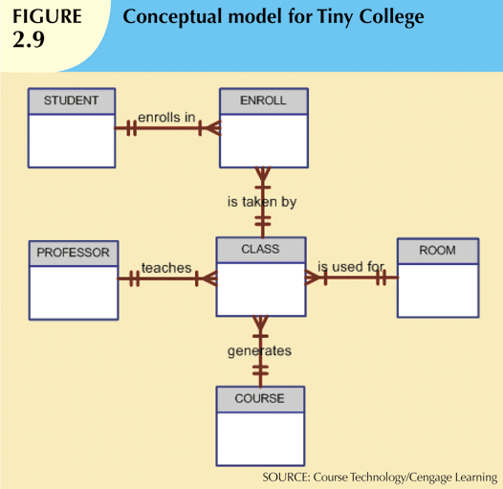
Database Systems, 10th Edition

Slide 56
The Conceptual Model (cont’d.)
Provides a relatively easily understood macro level view of data environment
Independent of both software and hardware
  Does not depend on the DBMS software used to implement the model
  Does not depend on the hardware used in the implementation of the model
  Changes in hardware or software do not affect database design at the conceptual level
Database Systems, 10th Edition

Slide 57
The Internal or Logical Model
Representation of the database as “seen” by the DBMS
  Maps the conceptual model to the DBMS
Internal schema depicts a specific representation of an internal model
Depends on specific database software
  Change in DBMS software requires internal model be changed
Logical independence: change internal model without affecting conceptual model
Database Systems, 10th Edition

Slide 58
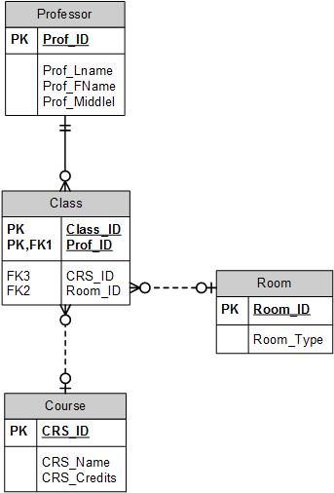
Logical Model
Database Systems, 10th Edition

Slide 59
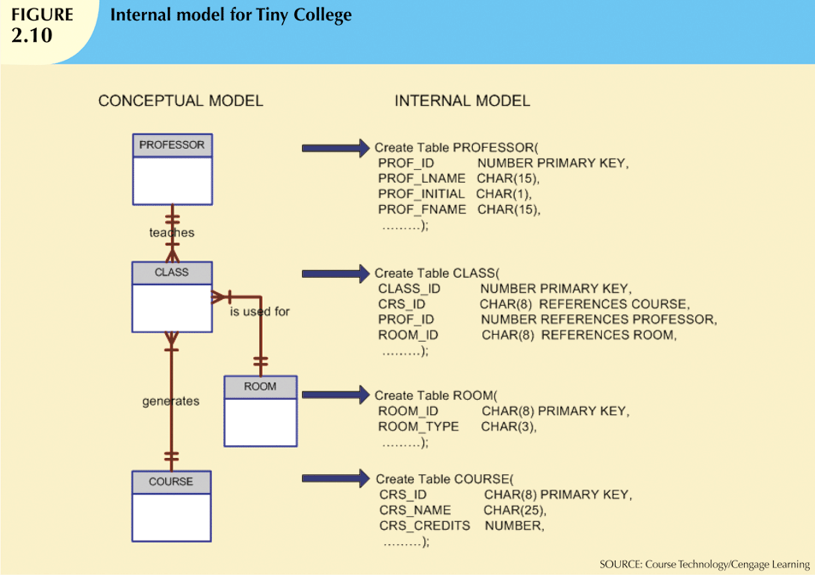
Database Systems, 10th Edition

Slide 60
The Physical Model
Operates at lowest level of abstraction
  Describes the way data are saved on storage media such as disks or tapes
Requires the definition of physical storage and data access methods
Relational model aimed at logical level
  Does not require physical-level details
Physical independence: changes in physical model do not affect internal model
Database Systems, 10th Edition

Slide 61
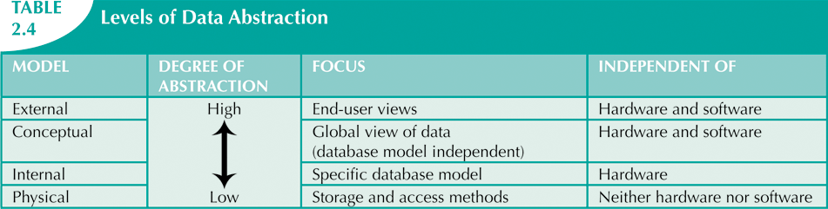
Database Systems, 10th Edition

Slide 62
Summary
A data model is an abstraction of a complex real-world data environment
Basic data modeling components:
  Entities
  Attributes
  Relationships
  Constraints
Business rules identify and define basic modeling components
Database Systems, 10th Edition

Slide 63
Summary (cont’d.)
Hierarchical model
  Set of one-to-many (1:M) relationships between a parent and its children segments
Network data model
  Uses sets to represent 1:M relationships between record types
Relational model
  Current database implementation standard
  ER model is a tool for data modeling
    Complements relational model
Database Systems, 10th Edition

Slide 64
Summary (cont’d.)
Object-oriented data model: object is basic modeling structure
Relational model adopted object-oriented extensions: extended relational data model (ERDM)
OO data models depicted using UML
Data-modeling requirements are a function of different data views and abstraction levels
  Three abstraction levels: external, conceptual, and internal
Database Systems, 10th Edition

